Slide 1

GIVUP: Automated Generation and Verification of Textual Process Descriptions
NIVON Quentin, SALAÜN Gwen, LANG Frédéric

Slide 2


Introduction
What is BPMN?
  A workflow-based notation created in 2004 by the Business Process Management Initiative (BPMI) and the Object Management Group (OMG).
  It aims at representing business processes in a way that is understandable for both experienced and novice users.
  An ISO/IEC standard since version 2.0 in 2013.

Slide 3
Introduction
What is BPMN?
  A workflow-based notation created in 2004 by the Business Process Management Initiative (BPMI) and the Object Management Group (OMG).
  It aims at representing business processes in a way that is understandable for both experienced and novice users.
  An ISO/IEC standard since version 2.0 in 2013.

Slide 4




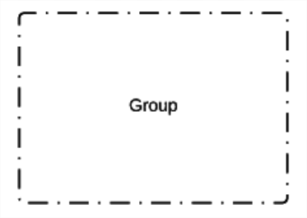



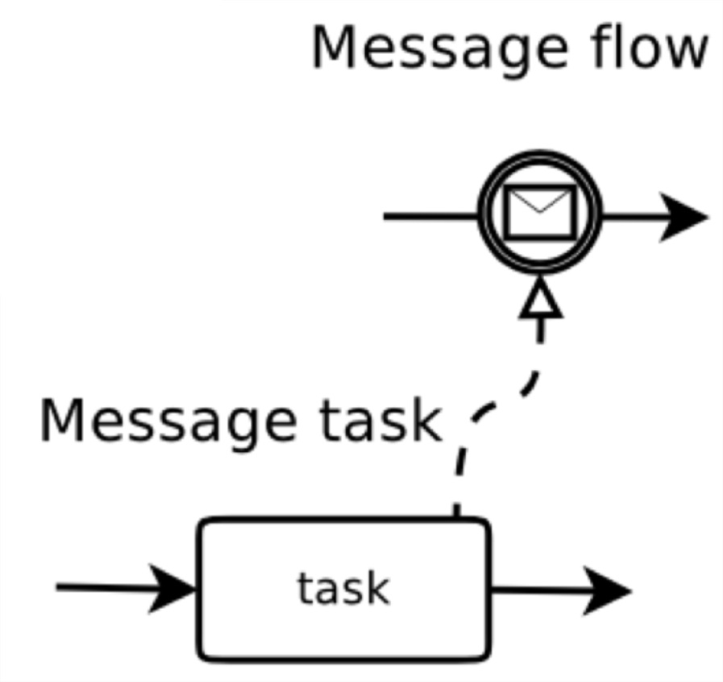



BPMN Syntax
Supported
Association
Sequence Flow
Task
Annotation
Initial Event
End Event
Event-based Gateway
Group
etc.
Exclusive Gateway
Parallel Gateway
Inclusive Gateway

Slide 5
Context
  Companies are making use of the BPMN notation to represent their business processes.
  They hire experts to analyse and design the most adequate BPMN process according to their needs.
  They also expect the experts to build a process having the
  desired behaviour.
  These processes are often syntactically/semantically incorrect.
  Often, they do not meet the expected requirements.

Slide 6
Research Questions
  What if you do not know how to write BPMN?
  What if you do not want to spend time designing your BPMN process graphically?
  How can you be sure that your BPMN process is syntactically/semantically correct?
  How can you be sure that your BPMN process has the expected behaviour?

Slide 7


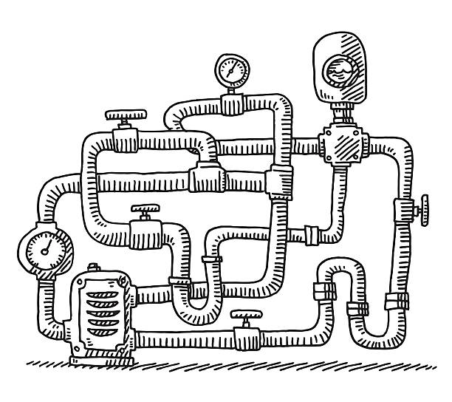

General Solution
1

Slide 8
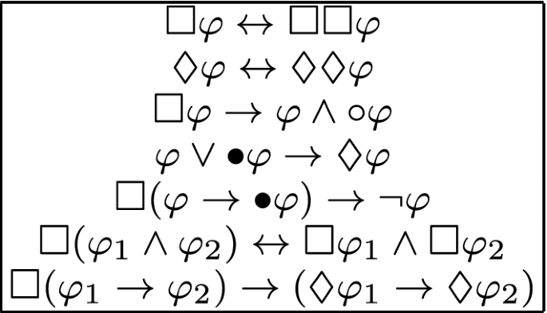
General Solution
1
2

Slide 9


General Solution
1
2
3

Slide 10
General Solution
1
2
Easier with patterns
3

Slide 11
Overview of our Solution for
1
First of all, an employee CollectGoods. Then, the client PayForDelivery while the employee PrepareParcel. Finally, the company can either DeliverByCar or DeliverByDrone (depending on the distance for example)
Textual Representation
of the Process

Slide 12

Overview of our Solution for
1
First of all, an employee CollectGoods. Then, the client PayForDelivery while the employee PrepareParcel. Finally, the company can either DeliverByCar or DeliverByDrone (depending on the distance for example)
Large Language
Model (LLM)
Textual Representation
of the Process

Slide 13



Overview of our Solution for
1
First of all, an employee CollectGoods. Then, the client PayForDelivery while the employee PrepareParcel. Finally, the company can either DeliverByCar or DeliverByDrone (depending on the distance for example)
- CollectGoods < (PayForDelivery, PrepareParcel)
- (PayForDelivery, PrepareParcel) < (DeliverByCar,
DeliverByDrone)
Large Language
Model (LLM)
Expressions Following an Internal Grammar
Textual Representation
of the Process

Slide 14

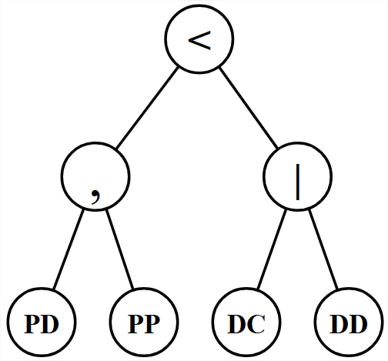
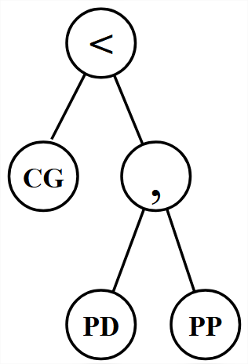
Overview of our Solution for
1
First of all, an employee CollectGoods. Then, the client PayForDelivery while the employee PrepareParcel. Finally, the company can either DeliverByCar or DeliverByDrone (depending on the distance for example)
- CollectGoods < (PayForDelivery, PrepareParcel)
- (PayForDelivery, PrepareParcel) < (DeliverByCar,
DeliverByDrone)
Large Language
Model (LLM)
Expressions Following an Internal Grammar
Textual Representation
of the Process
Abstract Syntax Trees

Slide 15

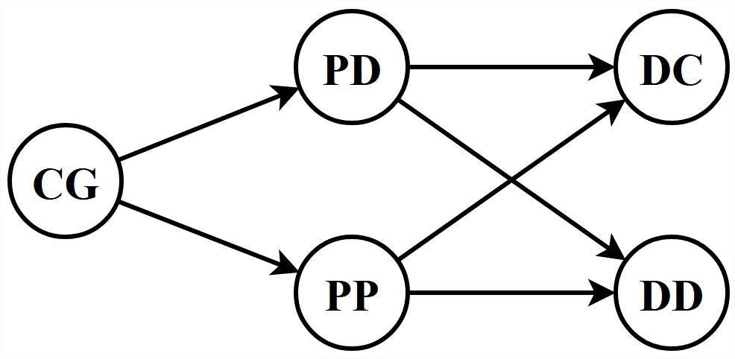
Overview of our Solution for
1
First of all, an employee CollectGoods. Then, the client PayForDelivery while the employee PrepareParcel. Finally, the company can either DeliverByCar or DeliverByDrone (depending on the distance for example)
- CollectGoods < (PayForDelivery, PrepareParcel)
- (PayForDelivery, PrepareParcel) < (DeliverByCar,
DeliverByDrone)
Large Language
Model (LLM)
Expressions Following an Internal Grammar
Textual Representation
of the Process
Dependency Graph
Abstract Syntax Trees

Slide 16
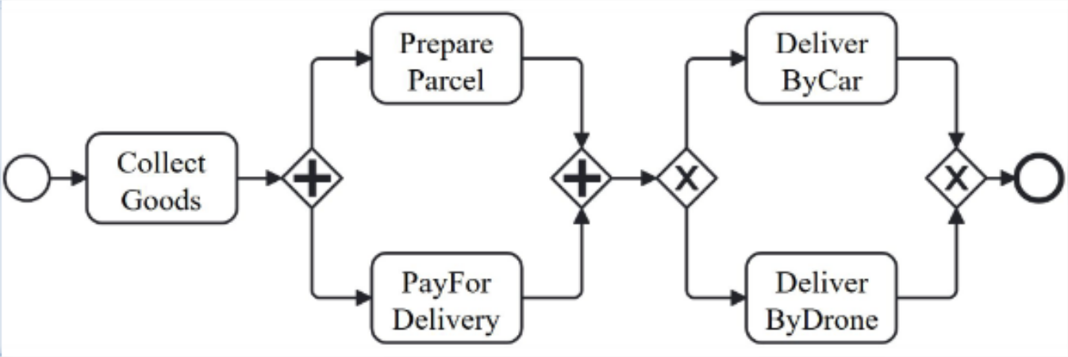
Overview of our Solution for
1
First of all, an employee CollectGoods. Then, the client PayForDelivery while the employee PrepareParcel. Finally, the company can either DeliverByCar or DeliverByDrone (depending on the distance for example)
- CollectGoods < (PayForDelivery, PrepareParcel)
- (PayForDelivery, PrepareParcel) < (DeliverByCar,
DeliverByDrone)
Large Language
Model (LLM)
Expressions Following an Internal Grammar
Textual Representation
of the Process
Dependency Graph
BPMN Process
Abstract Syntax Trees

Slide 17
Detailed Solution of – Step 1
1
The user first has to write a textual description of the process-to-be.
First, the banker either CreateProfile (CP) for the user, or, if it is not
needed, he RetrieveCustomerProfile (RCP) which triggers the system to perform the AnalyseCustomerProfile (ACP) task.
Then, the user executes the task ReceiveSupportDocuments (RSD) so that the system can start UpdateInfoRecords (UID) and perform a BackgroundVerification (BV).
If the verification finds missing or incorrect information, the system RequestAdditionalInfo (RAI) to the user, who has to ReceiveSupportDocuments (RSD) again.
Otherwise, the process ends with CreateAccount (CA).

Slide 18

Detailed Solution of – Step 2
1
The textual description is then given to a (fine-tuned) LLM (GPT 3.5 atm).
First, the banker either CreateProfile (CP) for the user, or, if it is not
needed, he RetrieveCustomerProfile (RCP) which triggers the system to perform the AnalyseCustomerProfile (ACP) task.
Then, the user executes the task ReceiveSupportDocuments (RSD) so that the system can start UpdateInfoRecords (UID) and perform a BackgroundVerification (BV).
If the verification finds missing or incorrect information, the system RequestAdditionalInfo (RAI) to the user, who has to ReceiveSupportDocuments (RSD) again.
Otherwise, the process ends with CreateAccount (CA).
- 3.5

Slide 19
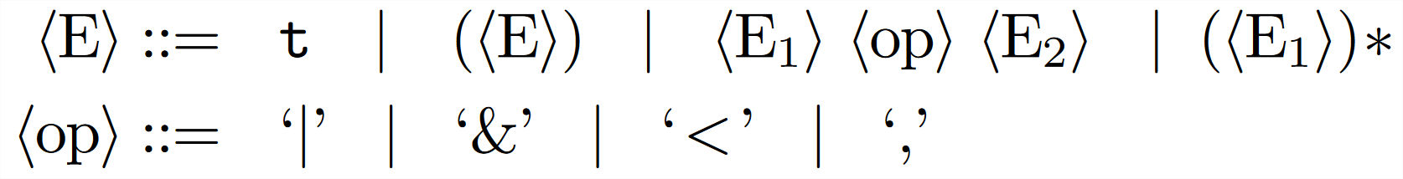
Detailed Solution of – Step 2
1
The textual description is then given to a (fine-tuned) LLM (GPT 3.5 atm).
First, the banker either CreateProfile (CP) for the user, or, if it is not
needed, he RetrieveCustomerProfile (RCP) which triggers the system to perform the AnalyseCustomerProfile (ACP) task.
Then, the user executes the task ReceiveSupportDocuments (RSD) so that the system can start UpdateInfoRecords (UID) and perform a BackgroundVerification (BV).
If the verification finds missing or incorrect information, the system RequestAdditionalInfo (RAI) to the user, who has to ReceiveSupportDocuments (RSD) again.
Otherwise, the process ends with CreateAccount (CA).
- 3.5
The LLM processes the description and returns a set of expressions following an internal grammar.

Slide 20
Detailed Solution of – Step 3
1
Given our description, the LLM returns three expressions:

Slide 21
Detailed Solution of – Step 3
1
Given our description, the LLM returns three expressions:
(RetrieveCustomerProfile < AnalyseCustomerProfile) | CreateProfile

Slide 22
Detailed Solution of – Step 3
1
Given our description, the LLM returns three expressions:
(RetrieveCustomerProfile < AnalyseCustomerProfile) | CreateProfile
(RetrieveCustomerProfile, AnalyseCustomerProfile, CreateProfile) < (ReceiveSupportDocuments < (UpdateInfoRecords, BackgroundVerification))

Slide 23
Detailed Solution of – Step 3
1
Given our description, the LLM returns three expressions:
(RetrieveCustomerProfile < AnalyseCustomerProfile) | CreateProfile
(RetrieveCustomerProfile, AnalyseCustomerProfile, CreateProfile) < (ReceiveSupportDocuments < (UpdateInfoRecords, BackgroundVerification))
(UpdateInfoRecords, BackgroundVerification) < ((RequestAdditionalInfo < ReceiveSupportDocuments) | CreateAccount)

Slide 24
Detailed Solution of – Step 4
1
These expressions are then mapped to their corresponding abstract syntax trees (ASTs).

Slide 25
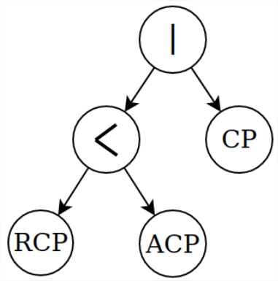
Detailed Solution of – Step 4
1
These expressions are then mapped to their corresponding abstract syntax trees (ASTs).

Slide 26
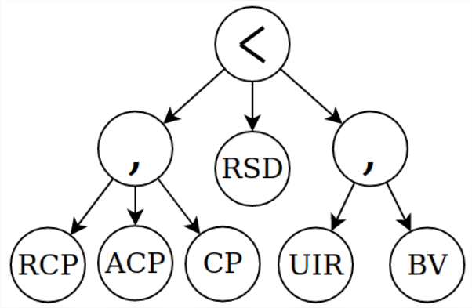
Detailed Solution of – Step 4
1
These expressions are then mapped to their corresponding abstract syntax trees (ASTs).

Slide 27
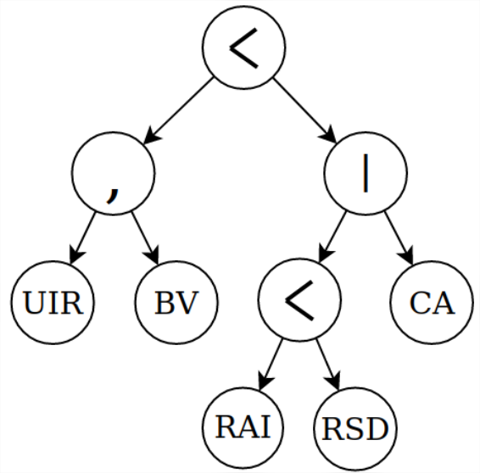
Detailed Solution of – Step 4
1
These expressions are then mapped to their corresponding abstract syntax trees (ASTs).

Slide 28
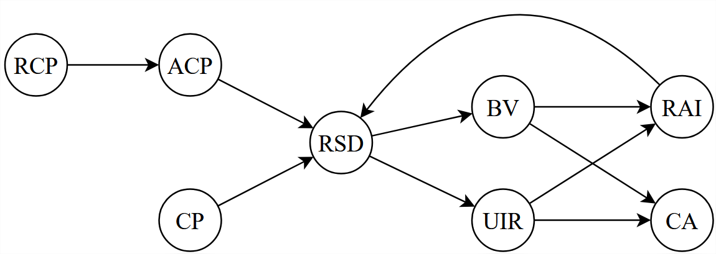
Detailed Solution of – Step 5
1
The sequential information contained in the multiple ASTs is gathered to obtain a cleaner representation of it, called dependency graph.

Slide 29
Detailed Solution of – Step 6
1
If the dependency graph contains loops, they are analysed, and all the information needed to reconstruct them is extracted.

Slide 30
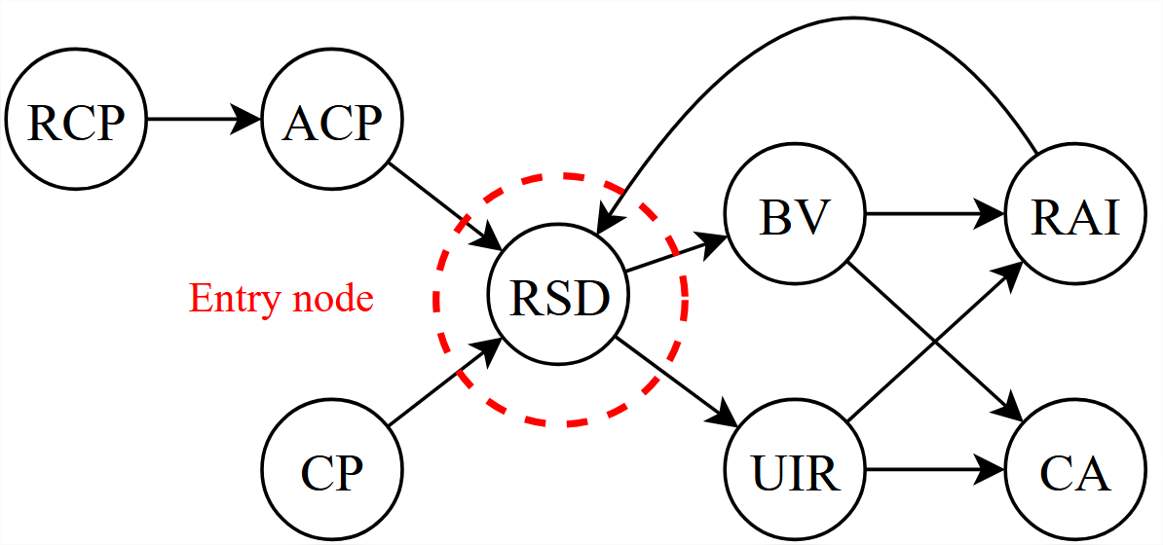
Detailed Solution of – Step 6
1
If the dependency graph contains loops, they are analysed, and all the information needed to reconstruct them is extracted.
Entry node(s) computation

Slide 31
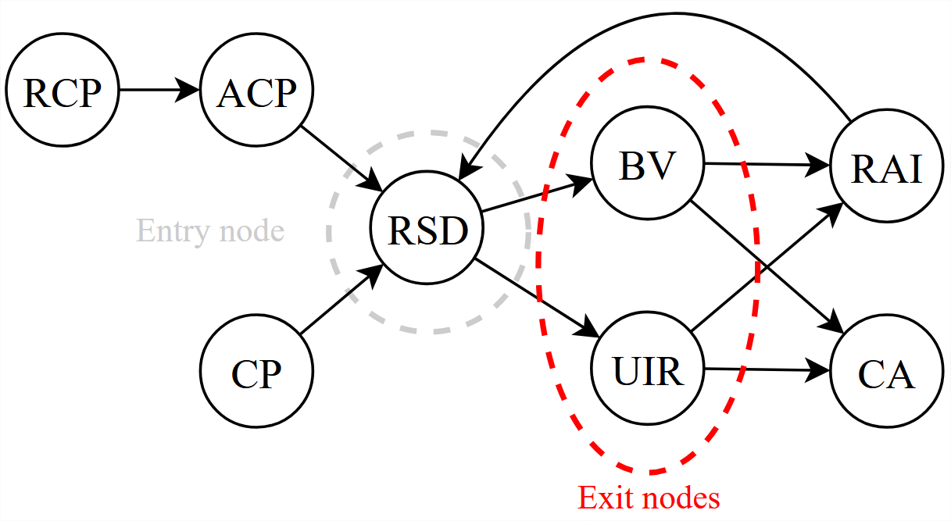
Detailed Solution of – Step 6
1
If the dependency graph contains loops, they are analysed, and all the information needed to reconstruct them is extracted.
Entry node(s) computation
Exit node(s) computation

Slide 32
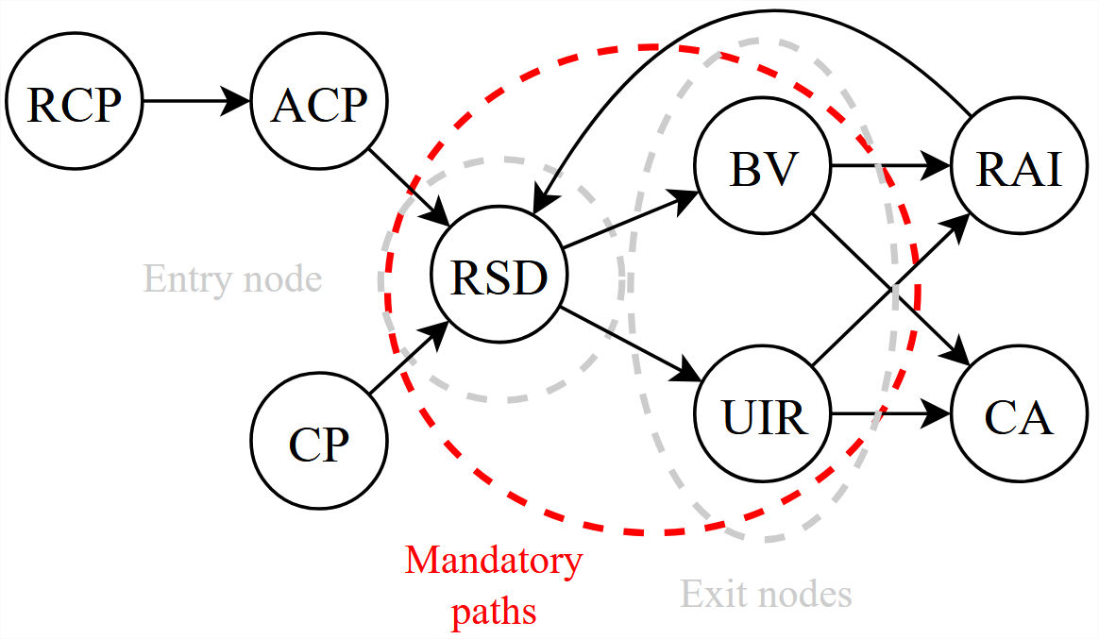
Detailed Solution of – Step 6
1
If the dependency graph contains loops, they are analysed, and all the information needed to reconstruct them is extracted.
Entry node(s) computation
Exit node(s) computation
Mandatory path(s) computation

Slide 33
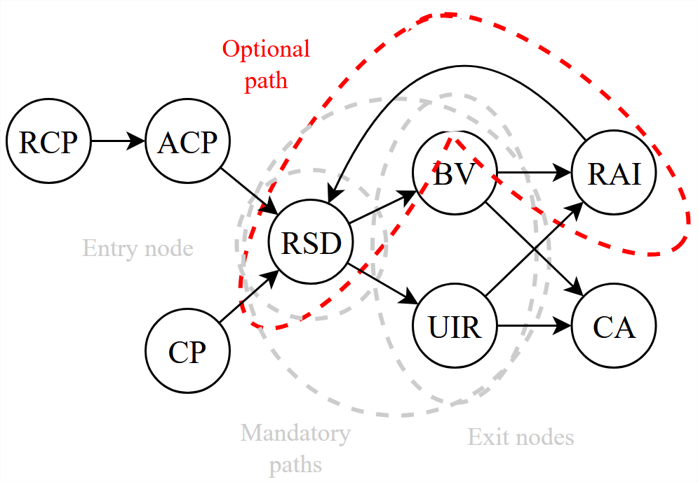
Detailed Solution of – Step 6
1
If the dependency graph contains loops, they are analysed, and all the information needed to reconstruct them is extracted.
Entry node(s) computation
Exit node(s) computation
Mandatory path(s) computation
Optional path(s) computation

Slide 34
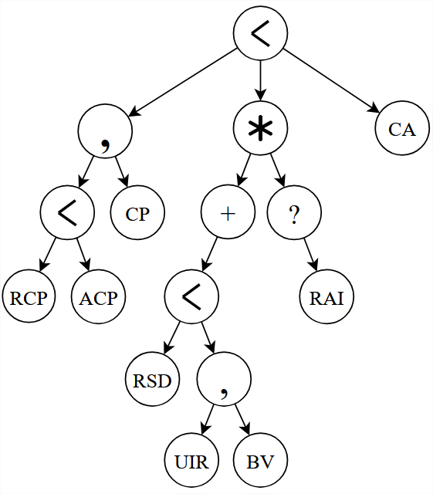
Detailed Solution of – Step 7
1
Once the loops have been retrieved, the AST corresponding to the dependency graph is built from the dependency graph.

Slide 35
Detailed Solution of – Step 8
1
The ultimate step to obtain an AST containing all the information belonging to the original expressions consists in inserting the choices.
(RCP < ACP) | CP
(RAI < RSD) | CA

Slide 36

Detailed Solution of – Step 8
1
The ultimate step to obtain an AST containing all the information belonging to the original expressions consists in inserting the choices.
(RCP < ACP) | CP
(RAI < RSD) | CA

Slide 37
Detailed Solution of – Step 8
1
The ultimate step to obtain an AST containing all the information belonging to the original expressions consists in inserting the choices.
(RCP < ACP) | CP
(RAI < RSD) | CA
Already included
due to the loop!

Slide 38
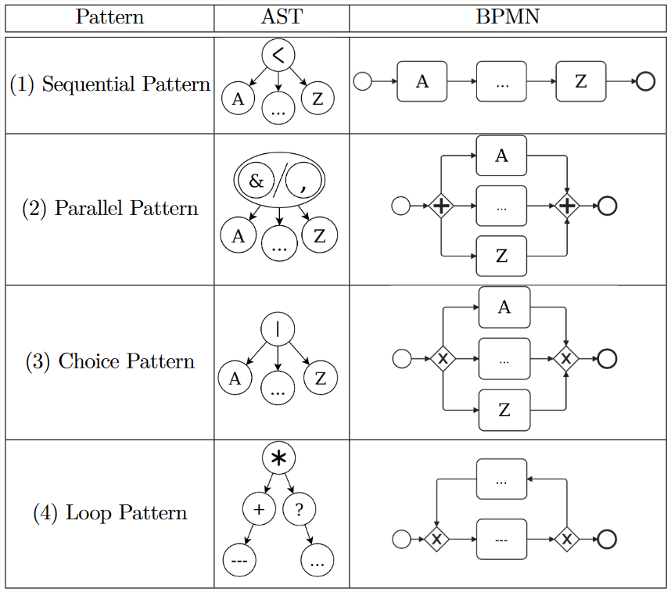
Detailed Solution of – Step 9
1
Now that the AST contains the choices, the BPMN process is ready to be generated.
To do so, patterns are applied recursively to the merged AST, starting from the deepest nodes (leafs).

Slide 39
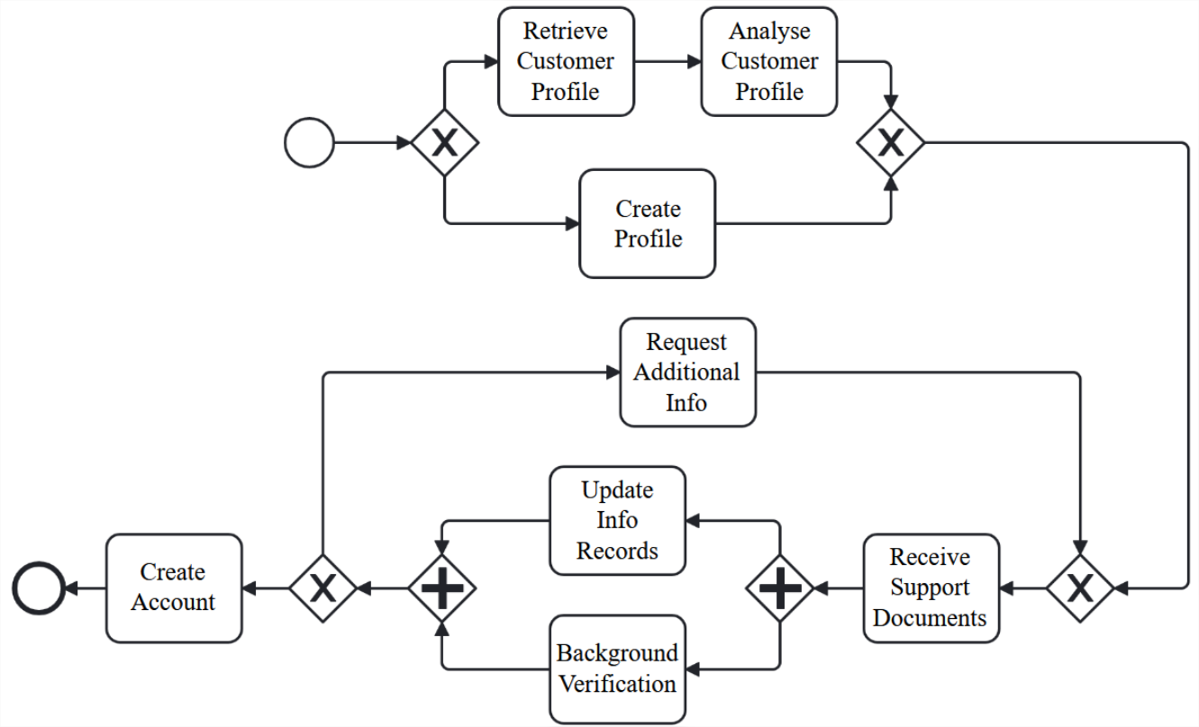
Detailed Solution of – Result
1

Slide 40
Overview of our Solution for
3
BPMN Process

Slide 41
Overview of our Solution for
3
VBPMN
BPMN Process

Slide 42
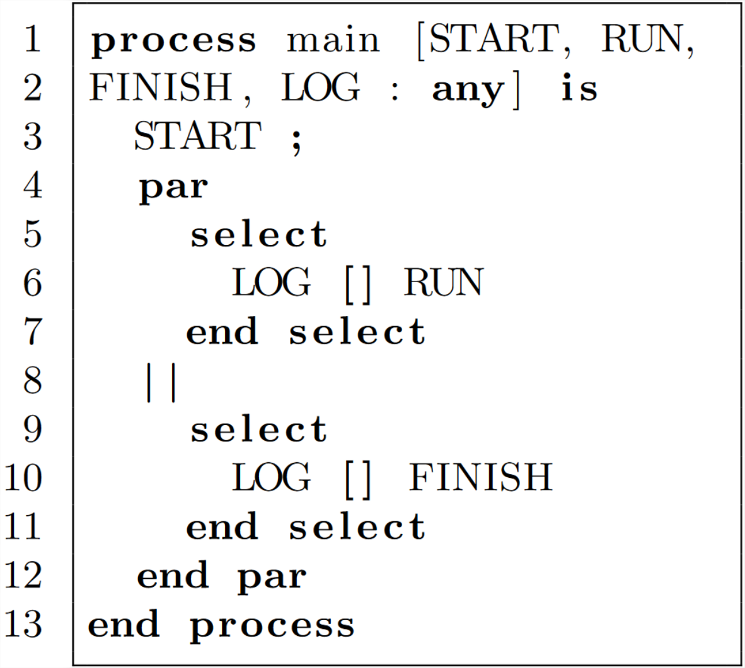
Overview of our Solution for
3
VBPMN
BPMN Process
LNT Specification

Slide 43
Overview of our Solution for
3
VBPMN
BPMN Process
LNT Specification

Slide 44
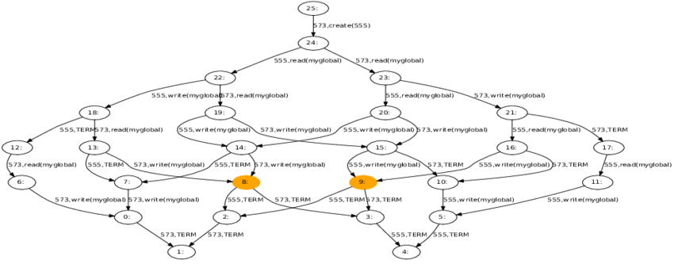
Overview of our Solution for
3
VBPMN
BPMN Process
BCG Specification
LNT Specification

Slide 45
Overview of our Solution for
3
VBPMN
BPMN Process
BCG Specification
LNT Specification
LTL Property

Slide 46

Overview of our Solution for
3
VBPMN
BPMN Process
BCG Specification
LNT Specification
LTL Property
SPOT Toolbox

Slide 47
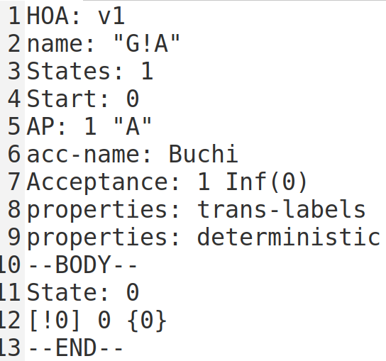
Overview of our Solution for
3
VBPMN
BPMN Process
BCG Specification
LNT Specification
LTL Property
SPOT Toolbox
Büchi Automaton (HOA Format)

Slide 48

Overview of our Solution for
3
VBPMN
BPMN Process
BCG Specification
LNT Specification
HOA2SVL
LTL Property
SPOT Toolbox
Büchi Automaton (HOA Format)

Slide 49
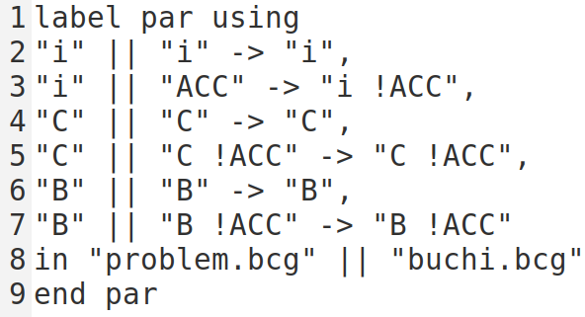
Overview of our Solution for
3
VBPMN
BPMN Process
BCG Specification
LNT Specification
.exp File
HOA2SVL
LTL Property
SPOT Toolbox
Büchi Automaton (HOA Format)

Slide 50
Overview of our Solution for
3
VBPMN
BPMN Process
BCG Specification
LNT Specification
.exp File
HOA2SVL
LTL Property
SPOT Toolbox
Büchi Automaton (HOA Format)
Büchi Automaton
(BCG Format)

Slide 51
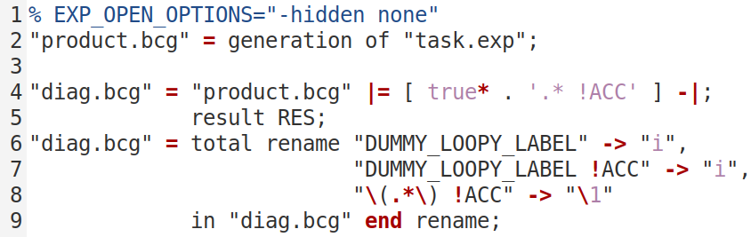
Overview of our Solution for
3
VBPMN
BPMN Process
BCG Specification
LNT Specification
.exp File
HOA2SVL
LTL Property
SPOT Toolbox
Büchi Automaton (HOA Format)
Büchi Automaton
(BCG Format)
SVL Script

Slide 52
Overview of our Solution for
3
SVL Script

Slide 53
Overview of our Solution for
3
SVL Script

Slide 54

Overview of our Solution for
3
SVL Script

Slide 55
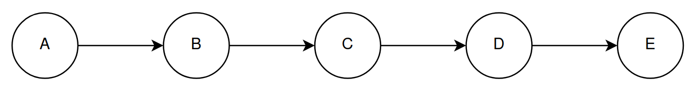
Overview of our Solution for
3
SVL Script
Counterexample

Slide 56
Overview of our Solution for
3
SVL Script
Counterexample
CLTS
Builder

Slide 57
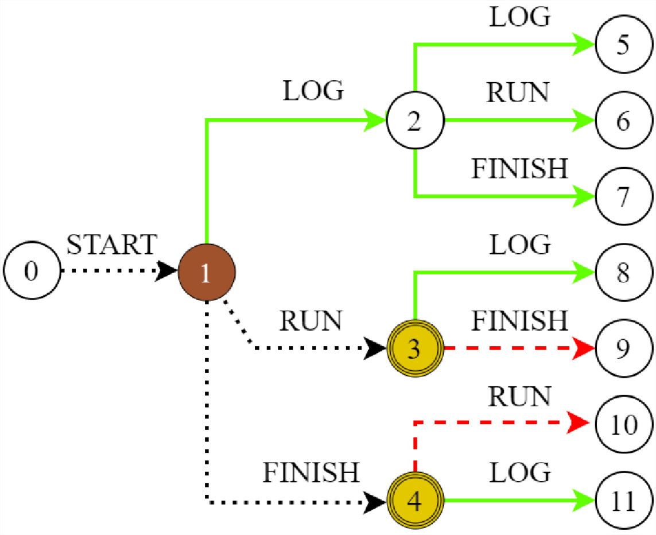
Overview of our Solution for
3
SVL Script
Counterexample
CLTS
Builder
CLTS

Slide 58
Overview of our Solution for
3
SVL Script
Counterexample
BPMN
Colorator
CLTS
Builder
CLTS

Slide 59
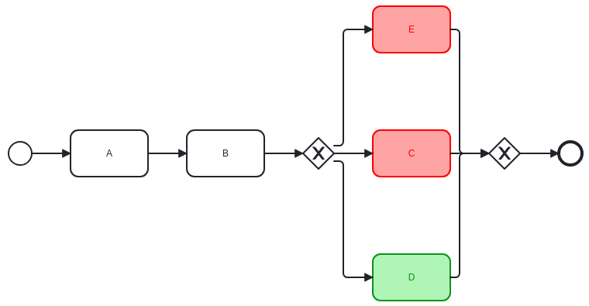
Overview of our Solution for
3
SVL Script
Counterexample
BPMN
Colorator
CLTS
Builder
Colored BPMN Process
CLTS

Slide 60
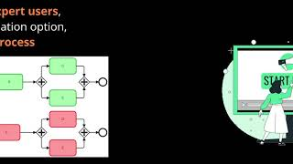
Tool – Presentation & Experiments

Slide 61
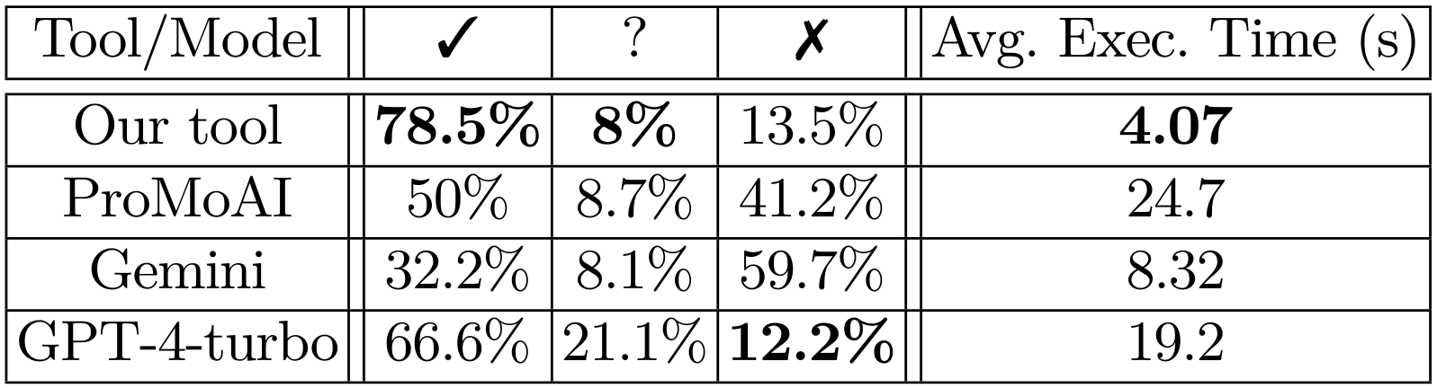
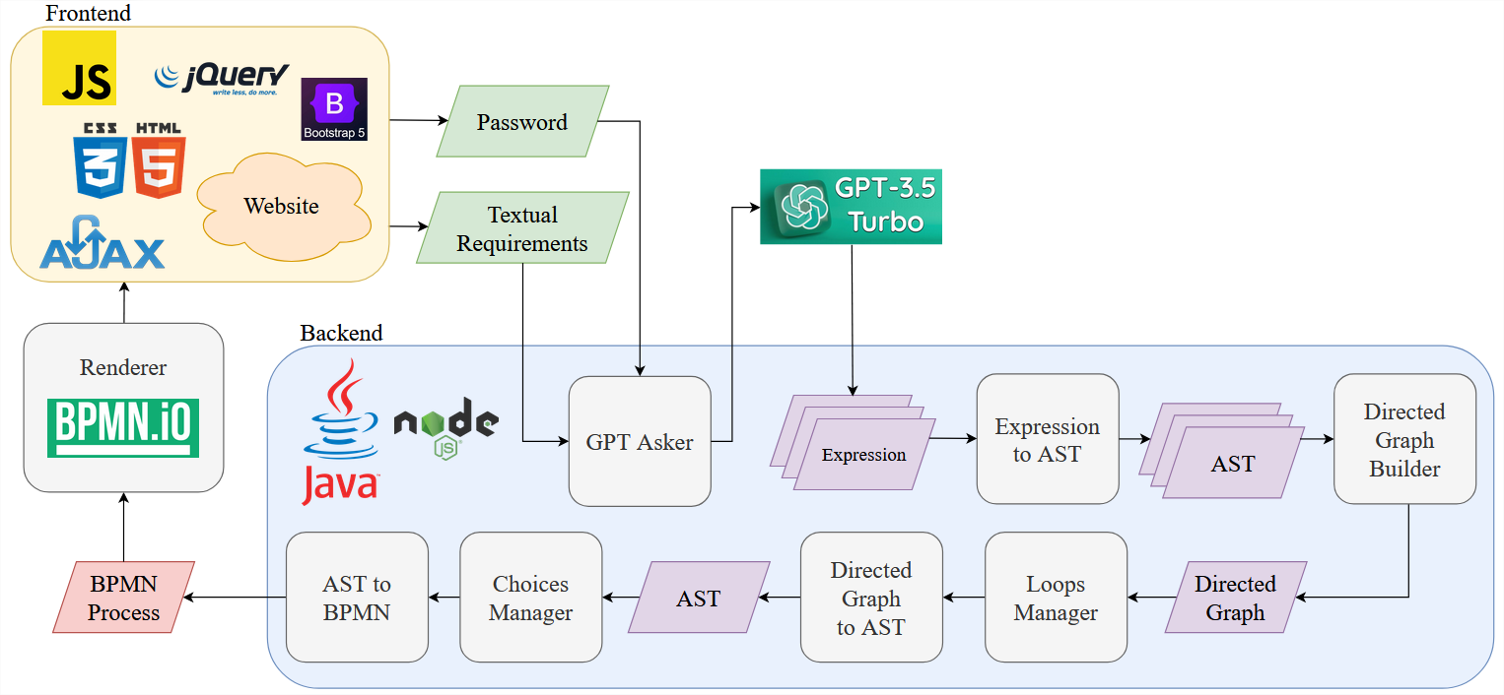
Tool – Presentation & Experiments

Slide 62
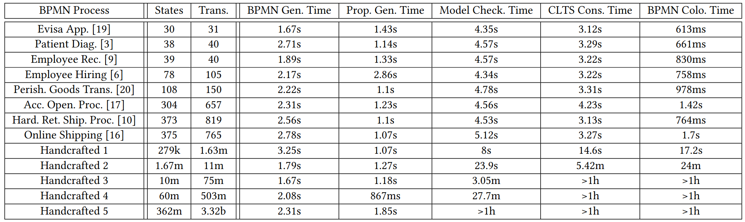
Tool – Presentation & Experiments
The LTL property is correctly generated in 100%.
Necessary otherwise the verification makes no sense.

Slide 63
Tool – Presentation & Experiments
The LTL property is correctly generated in 100%.
Necessary otherwise the verification makes no sense.
Starts getting (very) long on LTSs with millions of states

Slide 64
Conclusion
In this work, we proposed a 9 steps approach aiming at automatically designing syntactically and semantically correct BPMN processes from a textual description of the requirements.
The main perspectives of this work are:
Support unbalanced workflows
Make use of more recent versions of GPT
Diversify supported LTL properties
Enrich the training dataset
Enlarge the supported BPMN syntax

